Slide 1
SEMurai Data Driven Integration Tests
Prepared By: Elazar Neeman / Eitan Shomrai / Shay Barazovsky
7/4/2021

Slide 2





Solution concept
Test Report
V | TP1
X | TP2
V | TP3
GIT SEMurai
Repo
Test CI Job
References
Test Packages

Slide 3

Test Package Recorder
SEMurai
Run regression
scenarios
Events & Query
Tests Suite
QA/DEV/PL
Start & Configure Recorder
Test Package (TP)
Recorder
Test Suite
Package

Slide 4
Test Package (TP)
Test Package (TP)
Arrange Data
Recipe
CCI
Assert Data
Metadata
Meas. Results
…
Software Versions
Scenario Description
Test Type

Slide 5
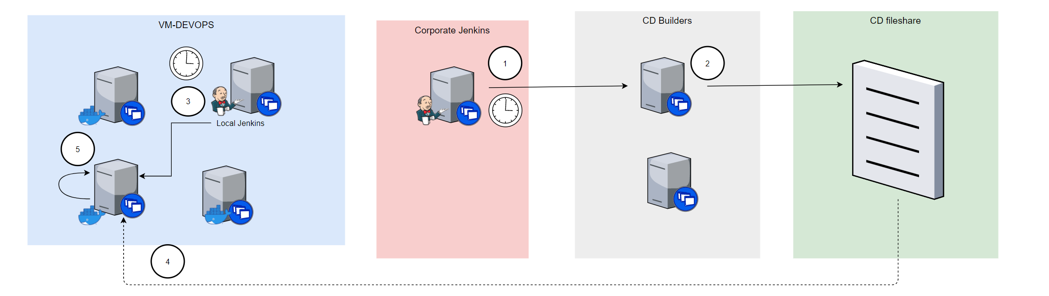


Test CI Job

Slide 6
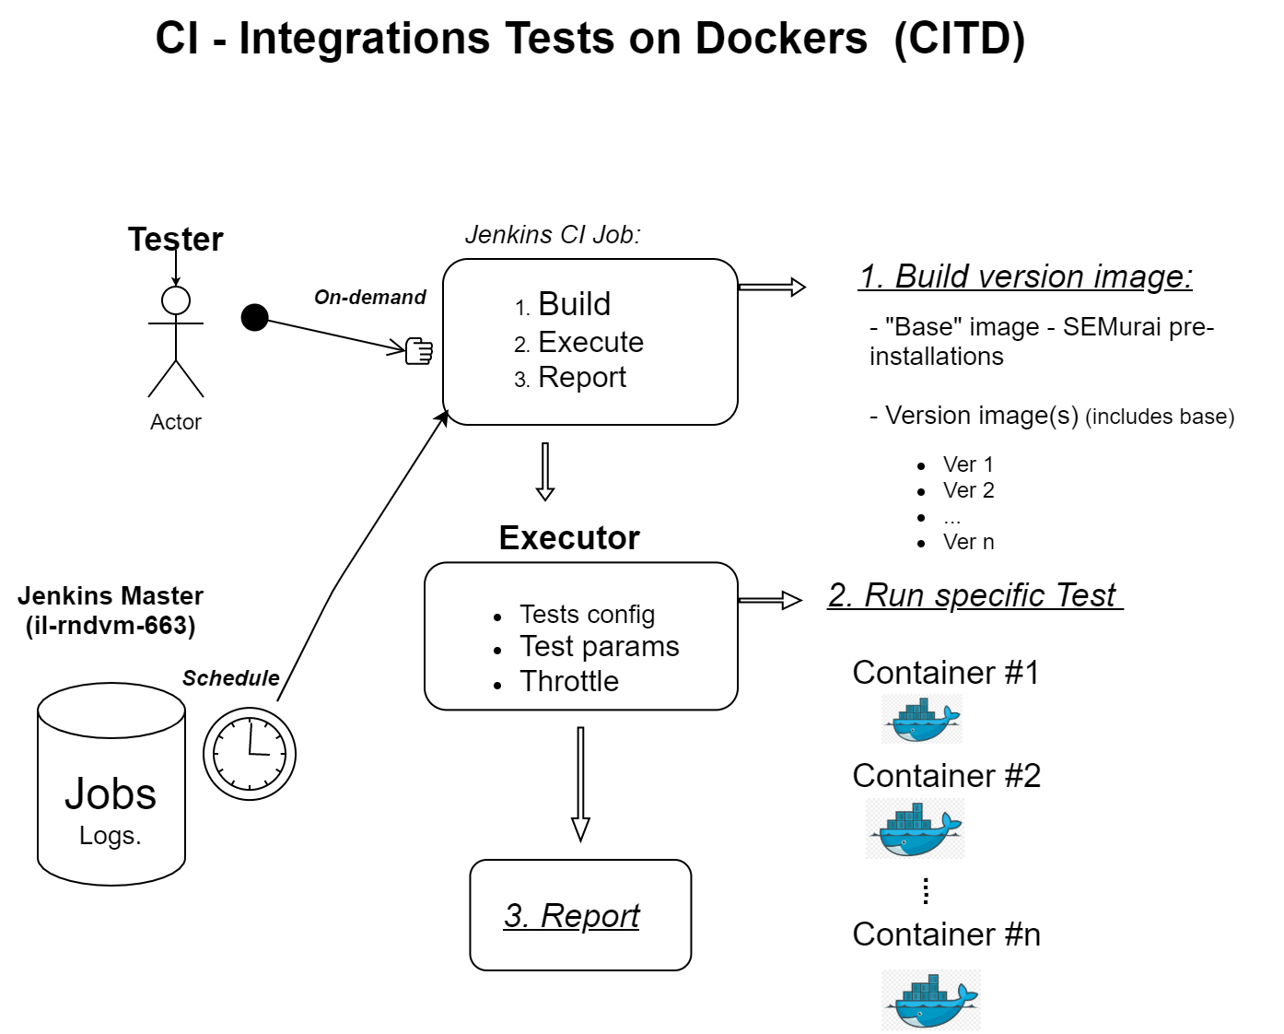
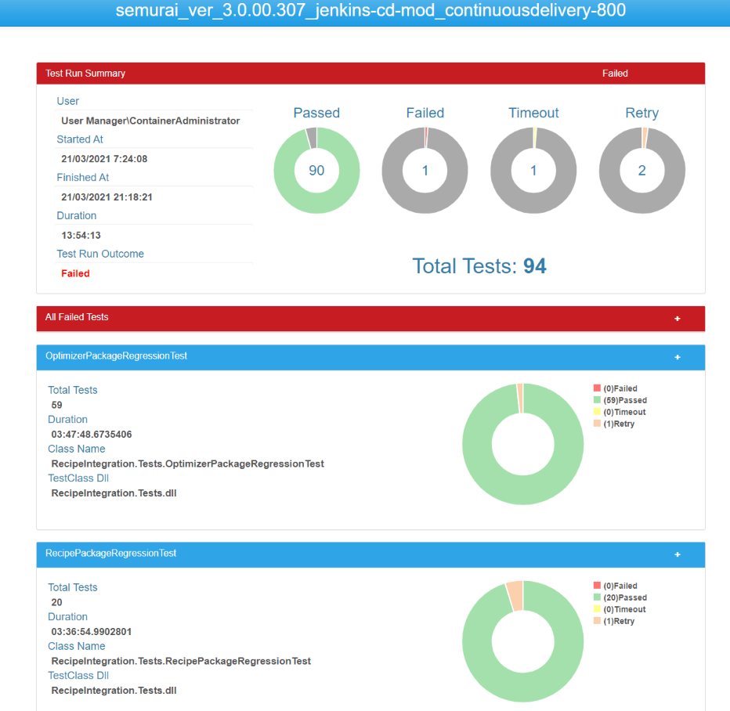

Slide 7
DEMO

Slide 8
Links
Sanity Job
http://il-poc-15:9090/job/CD/job/IntegrationTests/job/CD_IntegrationTests_Main/
Integration Tests on Docker Job
http://il-rndvm-663:9090/view/Host%207022/job/CITD-Full%20Cycle%20(7022)/build?delay=0sec
Version test reports
\\vm-devops-7022\CT_Workspace\bin.tests\TestResults\Reports\

Slide 9
Next Steps
Project Adoption plan
Project Adoption pilot
Move to Production Environment
Run cluster of dockers to allow run many tests in parallel

